Slide 1
Effects of Surface Temperature Change on Climate-related Disaster
Prepared By-
Tanvir Tanjum Shourav
Matriculation Id. 23392255
MSc. in Data Science
Methods of Advanced Data Engineering
Summer 2024
Friedrich-Alexander-Universität Erlangen-Nürnberg

Slide 2
Topics
Main Question
Used Data
Pipeline
Analysis
Findings

Slide 3

Main Question
How have different regions around the world been affected by changes in surface temperature in terms of climate-related disasters?

Slide 4
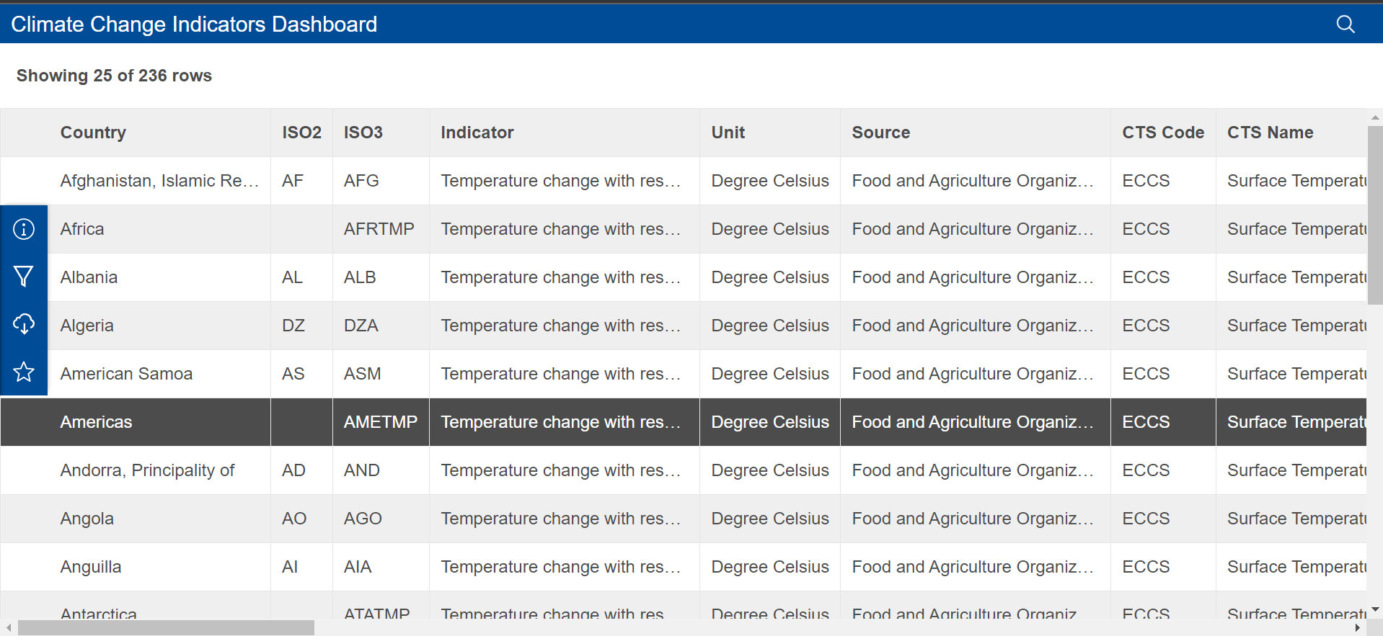
Used Data
Annual Surface Temperature Change
Metadata URL: https://climatedata.imf.org/datasets/4063314923d74187be9596f10d034914/explore
Data URL: https://opendata.arcgis.com/datasets/4063314923d74187be9596f10d034914_0.csv
Data Type: CSV
Description: This dataset shows annual estimates of mean surface temperature change measured with respect to a baseline climatology, corresponding to the period 1961-2022.
Data Structure: Semi-structured Data

Slide 5
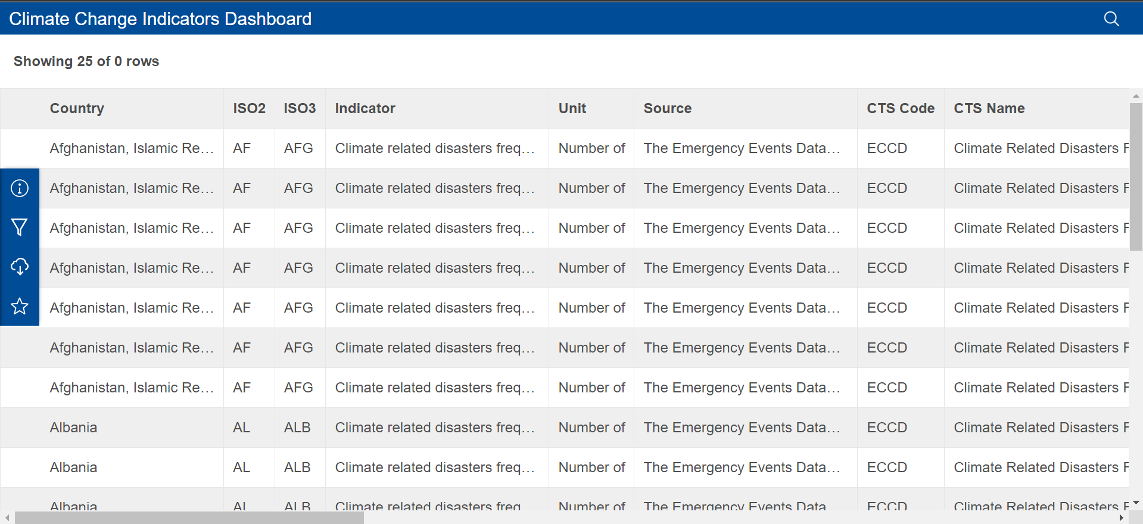
Used Data
Climate-related Disasters Frequency
Metadata URL: https://climatedata.imf.org/datasets/b13b69ee0dde43a99c811f592af4e821/explore
Data URL: https://opendata.arcgis.com/datasets/b13b69ee0dde43a99c811f592af4e821_0.csv
Data Type: CSV
Description: This dataset shows number of climate related natural disasters between 1980-2022.
Data Structure: Semi-structured Data

Slide 6
Used Data
License
“Fair use” of IMF published content is considered the non-systematic excerption or quoting of IMF content by individuals (e.g., academics, journalists, students, IMF country authorities, etc.) for non-commercial purposes such as criticism, comment, news reporting, teaching, scholarship, or research. Such “fair use” is authorized for up to 2,500 words from any one source. The IMF requests in such cases that individuals provide a complete citation to clearly identify the source(s) of the excerpted/quoted IMF material to their readers.
Visit - https://www.imf.org/external/terms.htm

Slide 7
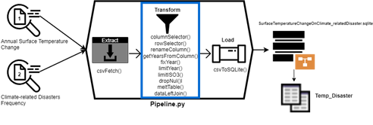
Pipeline
Used Techs-
Python 3
a. Pandas
b. sqlite3
c. colormap
d. matplotlib
ETL Pipeline.
E – Extract
T – Transform
L – Load

Slide 8
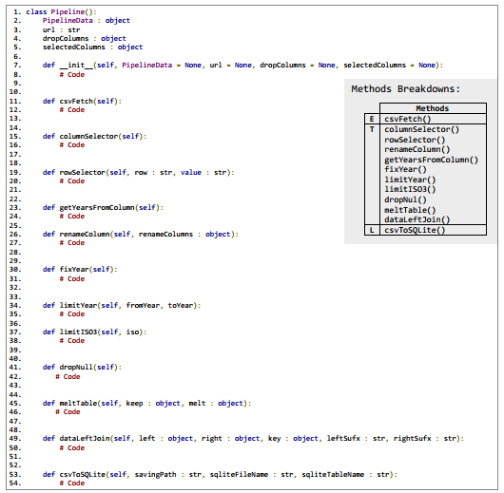
Pipeline

Slide 9
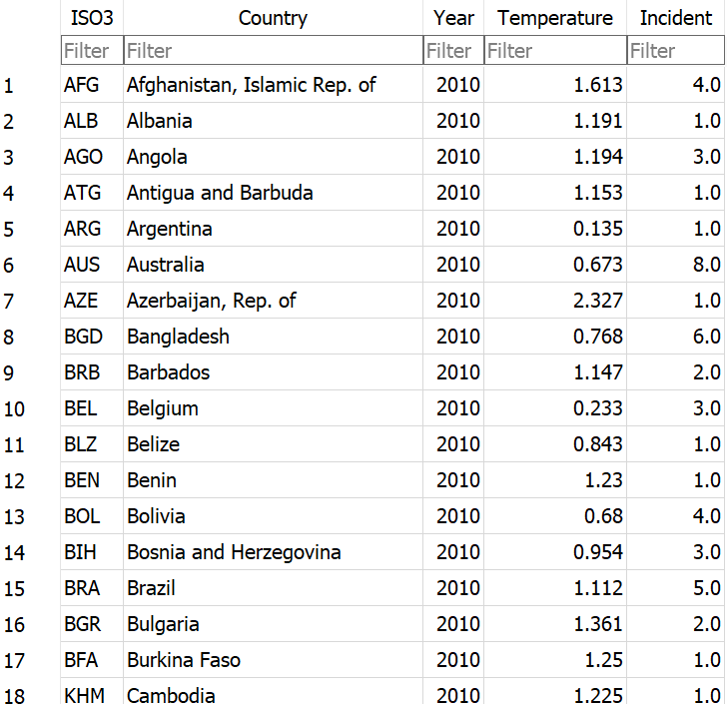
Pipeline

Slide 10
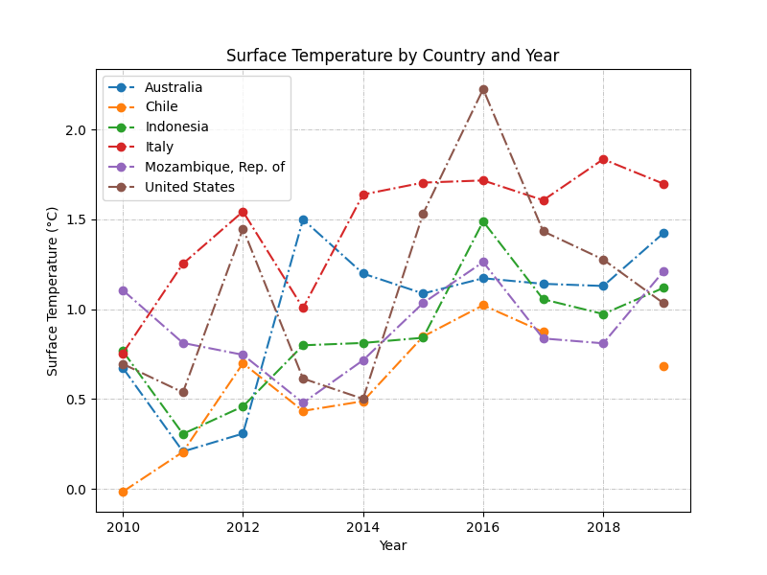
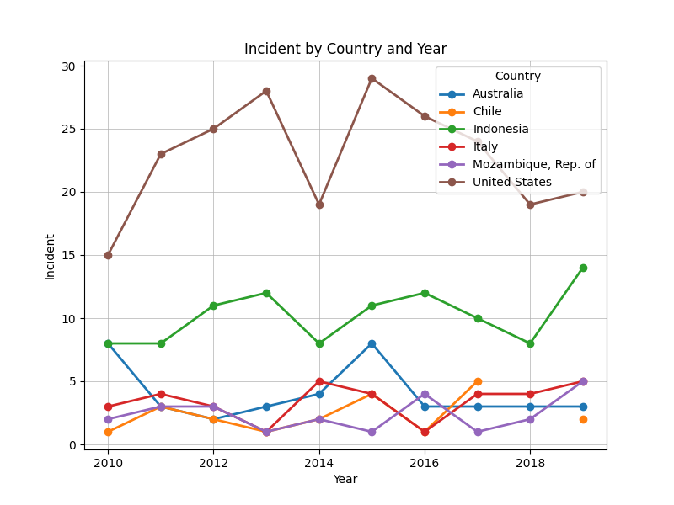
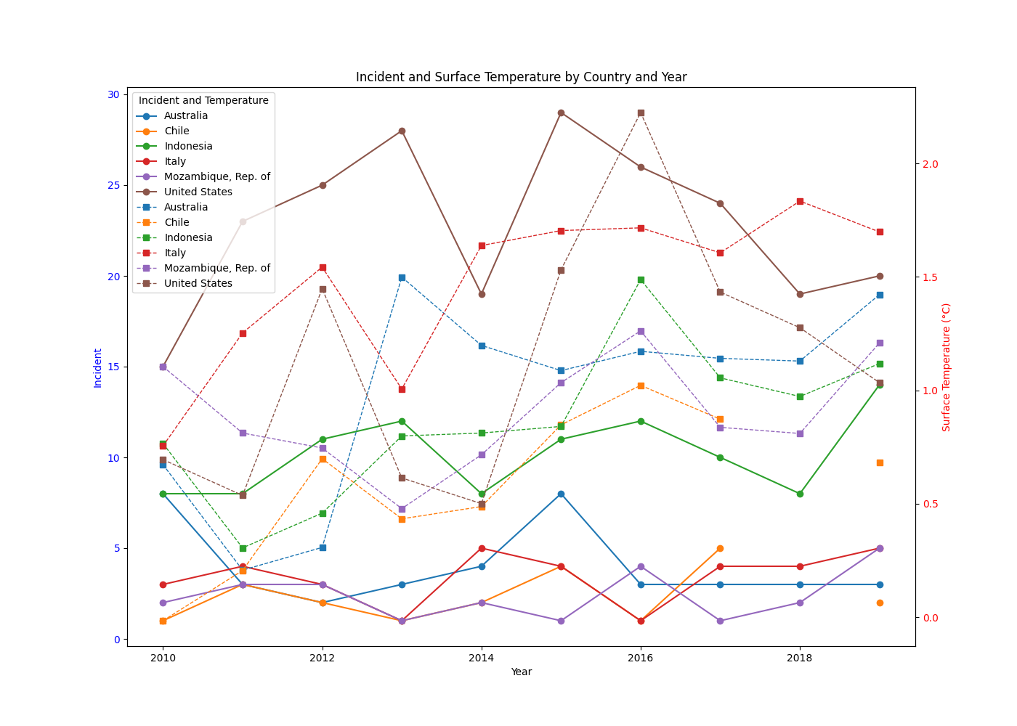
Analysis

Slide 11
Observation
It is as well possible to believe that the temperature anomalies are increasing, and the incidents number is growing as well, especially in the USA and Indonesia. Be that as it may, this implies that there is likelihood that the cases of such incidents are linked with increase in temperature as well.

Slide 12
Thank you

